Slide 1
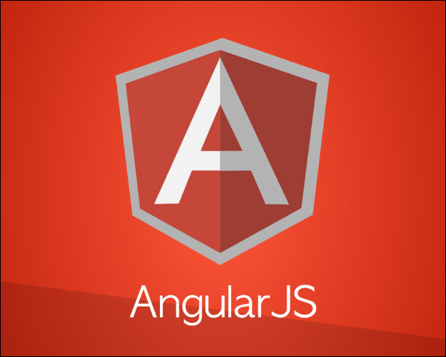
Angular JS Framework
Adit Kulkarni
Msis 517 Web technologies

Slide 2
Agenda
This presentation gives us basic understanding of Angular JS Framework, through this presentation I will address questions like What is Angular JS ? Why is it different ? How to Install it ? And the benefits of it’s implementation. The topic covered will be as given below –
Introduction to Angular JS
Benefits of implementing Angular JS.
Installation of Angular JS.
Key Features of Angular JS.
Angular JS implementation examples.
Demo Code
Demo Site
References

Slide 3
Introduction to Angular JS
What is Angular JS ?
Angular JS is a Java Script based structural framework which is majorly maintained by Google.
Open source framework which is also maintained by a community which includes corporations and individuals.
The first release of this framework was on 20th October 2018.
It was first developed in 2009 by a group of developers who worked at Brat Tech LLC.
Angular JS works on Client – Side.
Angular JS uses HTML as a template and lets you add HTML vocabulary with the help of directives.

Slide 4
Introduction to Angular JS
Angular JS works along with various servers.
It also enables developers to work cross browser.
Angular JS reduces coding – It implements two – way data binding which enables the user to manipulate the DOM with minimal code as compared to Jquery.

Slide 5
Introduction to Angular JS
How is Angular JS different from other Frameworks ?
Originally HTML was not designed for Dynamic Views.
Other frameworks try to completely remove HTML, CSS or JavaScripts by providing a way to manipulate the DOM.
Angular JS lets the developer use HTML as a template and then extends its abilities.

Slide 6
Benefits of implementing Angular JS
What can we do with Angular JS ?
Angular JS has Custom Directives, these directives help the developer to create new HTML syntax as per their needs.
The Custom directives are also used to create re usable components, this encapsulates the complex DOM structure which enables the developers to focus more on the application.
Better Navigation – Angular JS has Deep Linking, this showcases the location of the user inside the application, users can email links or bookmark their location for further use and ease of accessibility within the app. With this feature Angular JS gives desktop application feel to web applications.

Slide 7
Benefits of implementing Angular JS
Form Validation – Angular JS enables the developers to declare form validation rules effectively by eliminating the need to write the a separate JavaScript code for this functionality.
Built – In Testability – Angular JS provides an end to end scenario runner which makes the application more testable.
Angular JS has Filters, these Filters allow to format the data as per the developers’ needs, this can be used in cases where for example temperature is to displayed, the unit for it would be degree Celsius or Fahrenheit, Angular JS accesses the browser and according to the locale / country it can display the temperature in correct units.

Slide 8
Installation of Angular JS
How to install Angular JS ?
Pre-requisites –
Verify if you have Node.js and NPM Package Manager
Check version of Node by executing the following command in your terminal –> node –v
Check version of NPM by executing the following command in your terminal –> npm –v
You can download the node.js and NPM at below given links –
https://nodejs.org/en/
https://docs.npmjs.com/about-npm/index.html

Slide 9
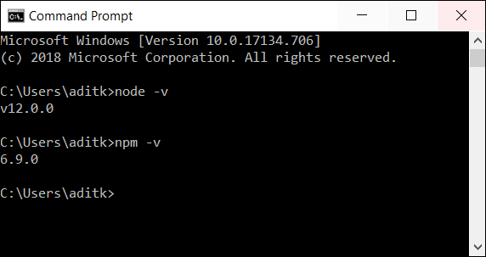
Installation of Angular JS

Slide 10
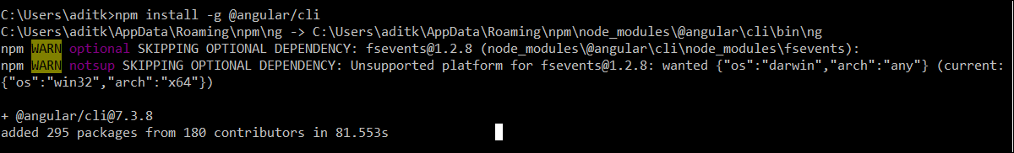
Installation of Angular JS
Step 1 – Install Angular CLI
Execute the following command in your terminal to initiate the installation of Angular CLI –>
npm install –g @angular/cli

Slide 11
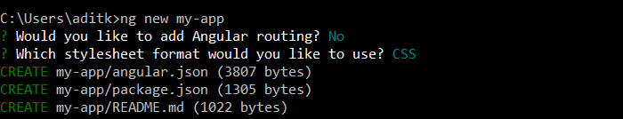
Installation of Angular JS
Step 2 – Workspace Creation
Execute the following command in your terminal to initiate creation of a workspace –>
ng new my-app
Note : This will prompt a few questions concerning the details of creation, hit Enter or Yes.

Slide 12

Installation of Angular JS
Step 3 – Open the Server
Execute the following command in your terminal to navigate to your app and open the server–>
cd my-app
ng serve –open
Note : Angular JS comes with a server so the user can host their application locally.

Slide 13
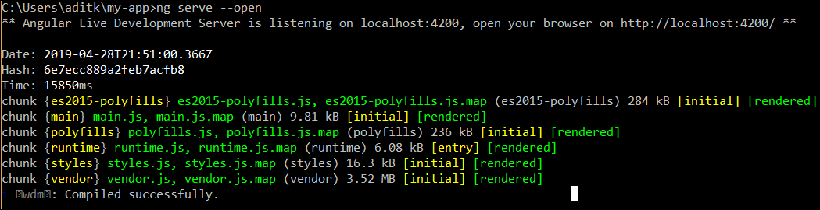
Installation of Angular JS
Step 3 – Open the Server
Once you execute the open command you will see code getting executed in your terminal, after that a browser will open which will be welcome page and you would know that the app is open.

Slide 14
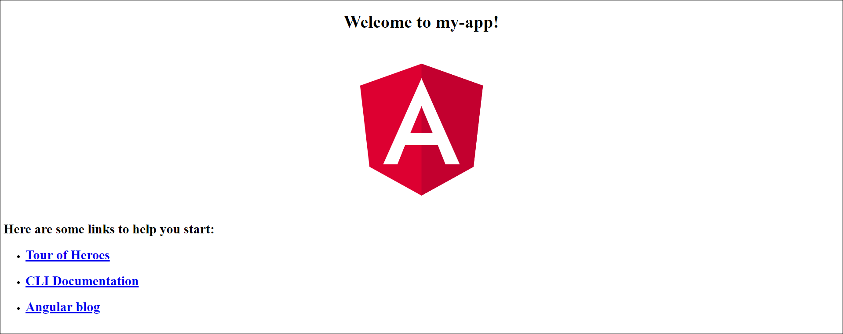
Installation of Angular JS
Step 3 – Open the Server
App opened

Slide 15

Key Features of Angular JS – MVC (Model – View – Controller)
Model
The Model layer will hold the data and the logic
Controller
View
Manipulates
Updates
The Controller layer manages the input events for the user, populate the view layer and interact with the Model layer
The View layer displays the content to the user as per the Angular JS templates using Directives and Filters, these consist of the styling and formatting code
Manages
Views
USER

Slide 16
Key Features of Angular JS – Two-Way Data Binding
Model
VIEW UPDATES THE MODEL
MODEL UPDATES THE VIEW
CONTINIOUS UPDATES
View

Slide 17
Angular JS Implementation Examples -
GOOGLE
DELTA AIRLINES WEBSITE
MICROSOFT OFFICE HOME
FORBES
NASDAQ BUSINESS
GIT HUB COMMUNITY FORUM
More Examples can be found on - https://www.madewithangular.com/

Slide 18
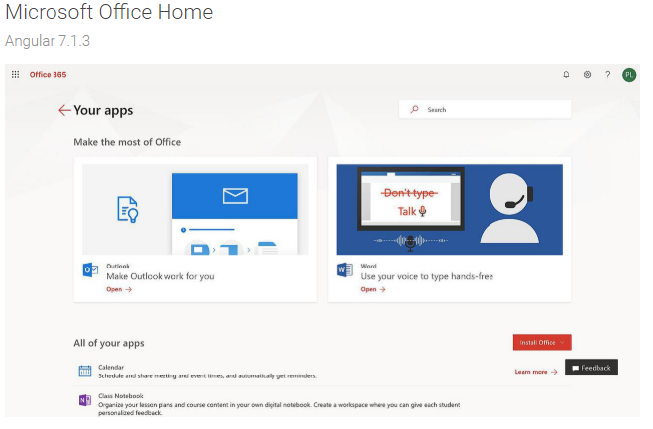
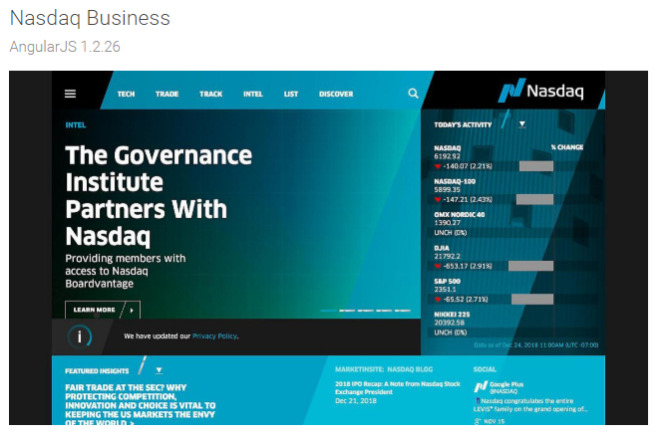
Angular JS Implementation Examples -

Slide 19
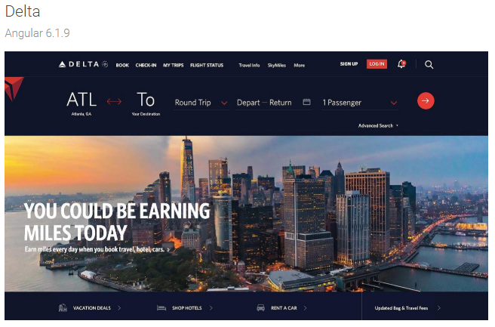
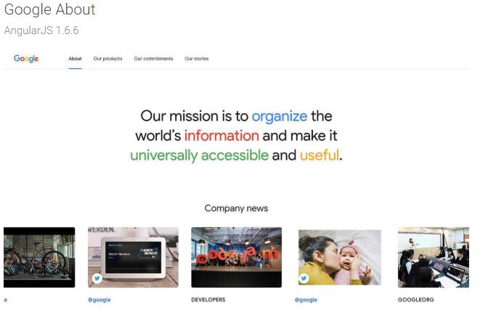
Angular JS Implementation Examples -

Slide 20
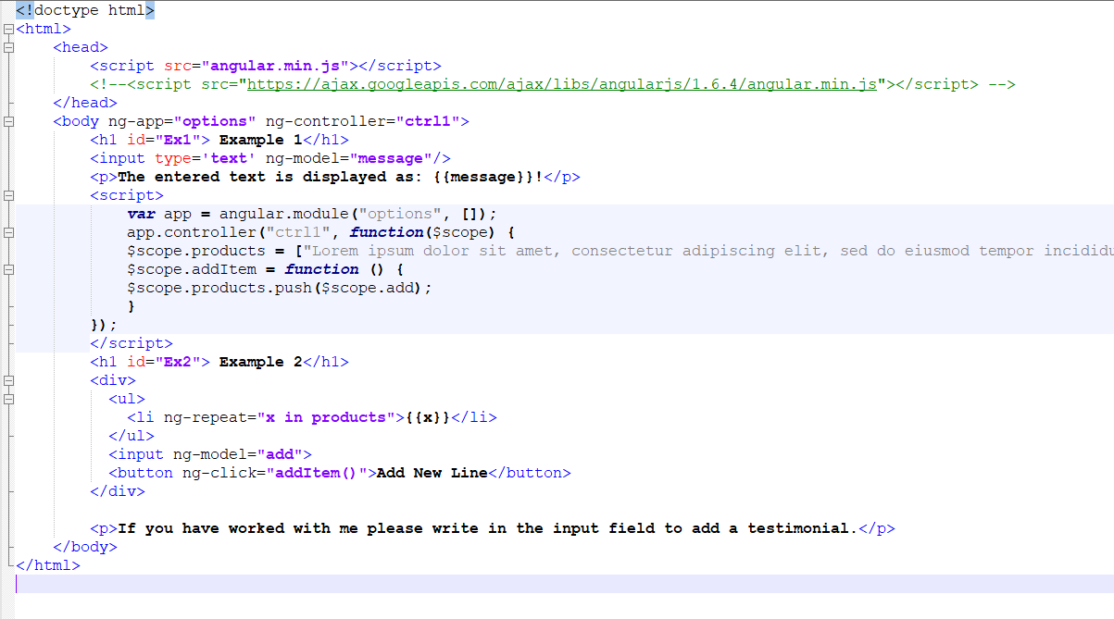
Demo Code

Slide 21
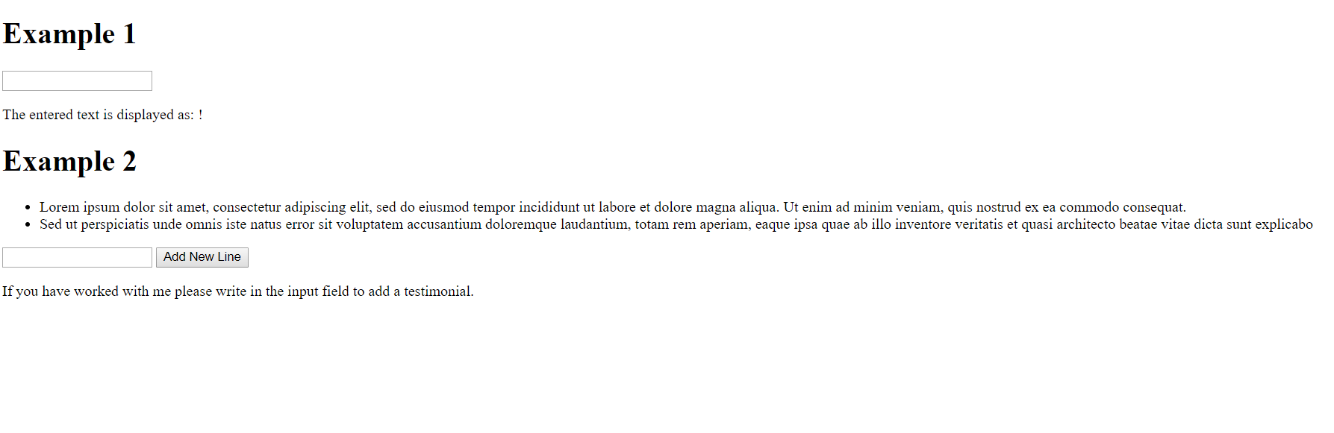
Demo Site

Slide 22
References-
https://angularjs.org/
https://docs.angularjs.org/guide/introduction
https://www.youtube.com/watch?v=o3Z8EY7tT-8 – Video Demo by Avnet Academy
https://www.madewithangular.com/
https://en.wikipedia.org/wiki/AngularJS
https://www.w3schools.com/angular/
https://www.guru99.com/angularjs-tutorial.html
https://thinkster.io/a-better-way-to-learn-angularjs
https://www.tutorialsteacher.com/angularjs/angularjs-tutorials

